Slide 1
Introduction to Data Structures

Slide 2
Introduction to Data Structures
Look around and you will see that people organize things:
Write TO-DO Lists
Queue at ATMs
Arrange stacks of books
Look-up words in dictionary
Organize directories in computers
Plan road map to go somewhere

Slide 3
Introduction
Data Structure can be defined as the group of data elements which provides an efficient way of storing and organizing data in the computer so that it can be used efficiently.
Some examples are arrays, Linked List, Stack, Queue, etc.
Widely used in almost every aspect of Computer Science.
i.e., Operating System, Compiler Design, Artifical intelligence, Graphics and many more.
Notes:
Data Structures are the main part of many computer science algorithms as they enable the programmers to handle the data in an efficient way. It plays a vitle role in enhancing the performance of a software or a program as the main function of the software is to store and retrieve the user’s data as fast as possible

Slide 4
Terminologies
Data – elementary value or the collection of values. Such as student’s name or ID.
Group Items – data items with subordinate data items. Such as student’s name consisting of first and last name.
Record – collection of various data items. Such as the record for student which contains the student’s name, address, contact details and etc.
File – Collection of various records. If there are 40 students in DSA, there are 40 records pertaining to those students.
Attribute and Entity – Entity represents the class, attribute represents property.
Field – A single elementary unit of information representing the attribute of an entity.

Slide 5
Why do we need Data Structures?
As our applications become more complex, with the more and more data used, issues may arise considering:
Processor Speed
Data Search
Multiple Requests
Notes:
Processor speed: To handle very large amout of data, high speed processing is required, but as the data is growing day by day to the billions of files per entity, processor may fail to deal with that much amount of data.
Data Search: Consider an inventory size of 106 items in a store, If our application needs to search for a particular item, it needs to traverse 106 items every time, results in slowing down the search process.
Multiple requests: If thousands of users are searching the data simultaneously on a web server, then there are the chances that a very large server can be failed during that process
In order to solve the above problems, data structures are used. Data is organized to form a data structure in such a way that all items are not required to be searched and required data can be searched instantly.

Slide 6
Advantages of Data Structures
The efficiency of a program depends on what data structure is being used.
Data structures are reusable.
Data structure specified by the abstract data type provides a level of abstraction.

Slide 7
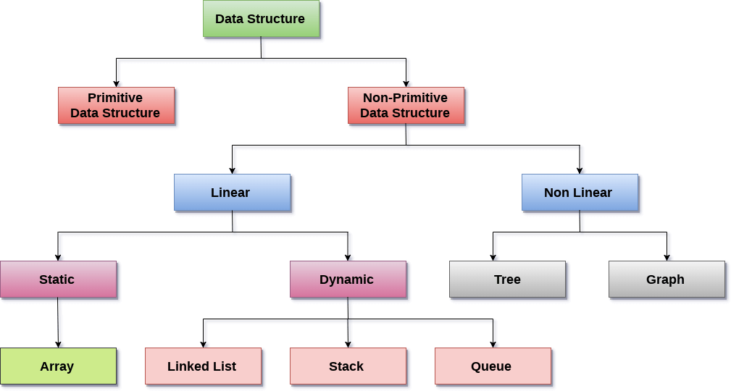
Classification

Slide 8
Linear Data Structures
A data structure is called linear if all of its elements are arranged in the linear order.
In linear data structures, the elements are stored in non-hierarchical way where each element has the successors and predecessors except the first and last element.
Array: A collection of similar type of data items, with each data item referred to as an element.
Linked List: A collection of nodes stored at non-contiguous memory locations.
Stack: A linear list in which insertion and deletions are allowed only at one end, the top.
Queue: A linear list in which elements can be inserted only at one end called rear and deleted only at the other end called front.

Slide 9
Non-Linear Data Structures
This data structure does not form a sequence.
i.e., each item or element is connected with two or more other items in a non-linear arrangement.
The data elements are not arranged in sequential structure.
Trees: Multilevel data structures with a hierarchical relationship among its elements that are called nodes.
Graphs: The pictorial representation of the set of elements (represented by vertices) connected by the links known as edges.

Slide 10
Operations on Data Structure
Traversing
Insertion
Deletion
Searching
Sorting
Merging
Notes:
1) Traversing: Every data structure contains the set of data elements. Traversing the data structure means visiting each element of the data structure in order to perform some specific operation like searching or sorting.
Example: If we need to calculate the average of the marks obtained by a student in 6 different subject, we need to traverse the complete array of marks and calculate the total sum, then we will devide that sum by the number of subjects i.e. 6, in order to find the average.
2) Insertion: Insertion can be defined as the process of adding the elements to the data structure at any location.
If the size of data structure is n then we can only insert n-1 data elements into it.
3) Deletion:The process of removing an element from the data structure is called Deletion. We can delete an element from the data structure at any random location.
If we try to delete an element from an empty data structure then underflow occurs.
4) Searching: The process of finding the location of an element within the data structure is called Searching. There are two algorithms to perform searching, Linear Search and Binary Search. We will discuss each one of them later in this tutorial.
5) Sorting: The process of arranging the data structure in a specific order is known as Sorting. There are many algorithms that can be used to perform sorting, for example, insertion sort, selection sort, bubble sort, etc.
6) Merging: When two lists List A and List B of size M and N respectively, of similar type of elements, clubbed or joined to produce the third list, List C of size (M+N), then this process is called merging

Slide 11
Pointers
A pointer is a variable that holds the memory address of another variable of the same type.
This memory address is the location of another variable where it has been stored in the memory.
It supports dynamic memory allocation routines.
int *ip; // pointer to an integer
double *dp; // pointer to a double
float *fp; // pointer to a float
char *ch // pointer to character

Slide 12
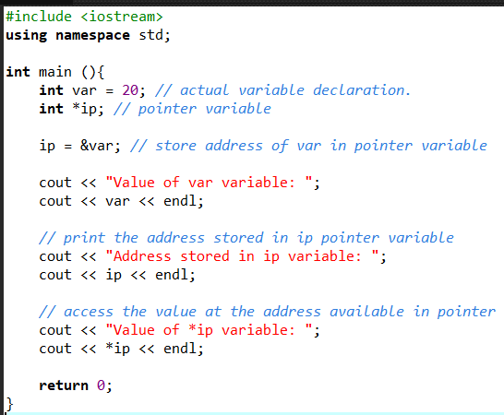

Slide 13
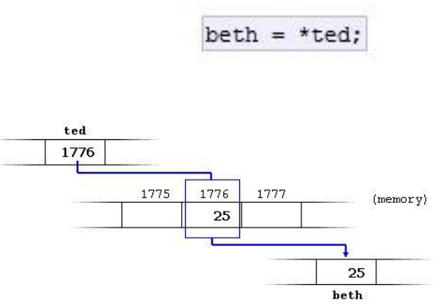
int bar = *foo_ptr;
*foo_ptr = 42;
& is the reference operator and can be read as "address of“
* is the dereference operator and can be read as "value pointed by"

Slide 14
Allocating Memory
There are two ways that memory gets allocated for data storage:
Compile Time (or static) Allocation
Memory for named variables is allocated by the compiler
Exact size and type of storage must be known at compile time
For standard array declarations, this is why the size has to be constant
Dynamic Memory Allocation
Memory allocated "on the fly" during run time
dynamically allocated space usually placed in a program segment known as the heap or the free store
Exact amount of space or number of items does not have to be known by the compiler in advance.
For dynamic memory allocation, pointers are crucial

Slide 15
Dynamic Memory Allocation
We can dynamically allocate storage space while the program is running, but we cannot create new variable names "on the fly"
For this reason, dynamic allocation requires two steps:
Creating the dynamic space.
Storing its address in a pointer (so that the space can be accesed)
To dynamically allocate memory in C++, we use the new operator.
De-allocation:
Deallocation is the "clean-up" of space being used for variables or other data storage
Compile time variables are automatically deallocated based on their known extent (this is the same as scope for "automatic" variables)
It is the programmer's job to deallocate dynamically created space
To de-allocate dynamic memory, we use the delete operator

Slide 16
Allocating space with new
To allocate space dynamically, use the unary operator new, followed by the type being allocated.
If creating an array dynamically, use the same form, but put brackets with a size after the type:
These statements above are not very useful by themselves, because the allocated spaces have no names! BUT, the new operator returns the starting address of the allocated space, and this address can be stored in a pointer:
new int; // dynamically allocates an int
new double; // dynamically allocates a double
new int[40]; // dynamically allocates an array of 40 ints
new double[size]; // dynamically allocates an array of size doubles
// note that the size can be a variable

Slide 17
Allocating space with new
Notice that this is one more way of initializing a pointer to a valid target (and the most important one).
int * p; // declare a pointer p
p = new int; // dynamically allocate an int and load address into p
double * d; // declare a pointer d
d = new double; // dynamically allocate a double and load address into d
// we can also do these in single line statements
int x = 40;
int * list = new int[x];
float * numbers = new float[x+10];

Slide 18
Accessing dynamically created space
So once the space has been dynamically allocated, how do we use it?
For single items, we go through the pointer. Dereference the pointer to reach the dynamically created target:
int * p = new int; // dynamic integer, pointed to by p
*p = 10; // assigns 10 to the dynamic integer
cout << *p; // prints 10

Slide 19
Accessing dynamically created space
For dynamically created arrays, you can use either pointer-offset notation, or treat the pointer as the array name and use the standard bracket notation:
double * numList = new double[size]; // dynamic array
for (int i = 0; i < size; i++)
numList[i] = 0; // initialize array elements to 0
numList[5] = 20; // bracket notation
*(numList + 7) = 15; // pointer-offset notation
// means same as numList[7]

Slide 20
Deallocation of dynamic memory
To deallocate memory that was created with new, we use the unary operator delete. The one operand should be a pointer that stores the address of the space to be deallocated:
Note that the pointer ptr still exists in this example. That's a named variable subject to scope and extent determined at compile time. It can be reused:
int * ptr = new int; // dynamically created int
// ...
delete ptr; // deletes the space that ptr points
ptr = new int[10]; // point p to a brand new array

Slide 21
Deallocation of dynamic memory
To deallocate a dynamic array, use this form:
delete [] name_of_pointer;
Example:
int * list = new int[40]; // dynamic array
delete [] list; // deallocates the array
list = 0; // reset list to null pointer
After deallocating space, it's always a good idea to reset the pointer to null unless you are pointing it at another valid target right away.

Slide 22
Memory Leak
A memory leak occurs when a piece (or pieces) of memory that was previously allocated by a programmer is not properly deallocated.
Even though the memory is not used by the program anymore, it is still “reserved” and that piece of memory cannot be used by the program until it is properly deallocated.
It is called a memory leak because it works like a leaky faucet where water is wasted – only in this case, it is the computer memory.

Slide 23
Review of Arrays
Arrays are defined as the collection of similar type of data items stored at contiguous memory locations.
Arrays are the derived data type in C programming language which can store the primitive type of data such as int, char, double, float, etc.
Array is the simplest data structure where each data element can be randomly accessed by using its index number.
Notes:
For example, if we want to store the marks of a student in 6 subjects, then we don’t need to define different variable for the marks in different subject. instead of that, we can define an array which can store the marks in each subject at a the contiguous memory locations.

Slide 24
Properties of the Array
Each element is of same data type and carries a same size i.e. int = 4 bytes.
Elements of the array are stored at contiguous memory locations where the first element is stored at the smallest memory location.
Elements of the array can be randomly accessed since we can calculate the address of each element of the array with the given base address and the size of data element.

Slide 25
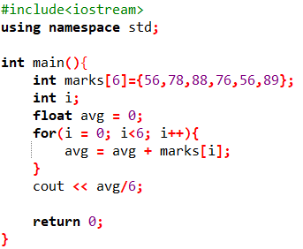
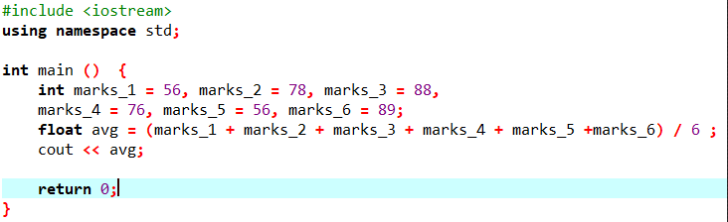
Need of using arrays

Slide 26
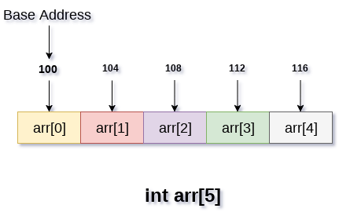
Memory Allocation of the array
Indexing is defined in three ways:
0 based indexing
1 based indexing
N based indexing
n the following image, we have shown the memory allocation of an array arr of size 5. The array follows 0-based indexing approach. The base address of the array is 100th byte. This will be the address of arr[0]. Here, the size of int is 4 bytes therefore each element will take 4 bytes in the memory.

Slide 27
Abstract Data Types (ADTs)
Data abstraction, or abstract data types, is a programming methodology where one defines not only the data structure to be used, but the processes to manipulate the structure
like process abstraction, ADTs can be supported directly by programming languages
To support it, there needs to be mechanisms for
defining data structures
encapsulation of data structures and their routines to manipulate the structures into one unit
by placing all definitions in one unit, it can be compiled at one time
information hiding to protect the data structure from outside interference or manipulation
the data structure should only be accessible from code encapsulated with it so that the structure is hidden and protected from the outside
objects are one way to implement ADTs, but because objects have additional properties, we defer discussion of them until the next chapter

Slide 28
ADT Design Issues
Encapsulation: it must be possible to define a unit that contains a data structure and the subprograms that access (manipulate) it
design issues:
will ADT access be restricted through pointers?
can ADTs be parameterized (size and/or type of data being stored)?
Information hiding: controlling access to the data structure through some form of interface so that it cannot be directly manipulated by external code
often implemented via two sections of code
public part (interface) constitutes those elements that can be accessed externally (often limited to subprograms and constants)
private part, which remains secure because it is only accessible by subprograms of the ADT itself

Slide 29
ADTs in C++
C++ offers two mechanisms for building data structures: the struct and the class
because the struct does not have a mechanism for information hiding, it can only offer encapsulation (and encapsulation is not enforced when using structs, merely available), so for a true ADT, we must use C++s object
C++ classes contain both visible (public) and hidden (private) components (as well as protected for inheritance)
C++ instances can be static, heap-dynamic and stack-dynamic
the lifetime of an instance ends when it reaches the end of the scope of where it was declared
a stack-dynamic object may have heap-dynamic data so that parts of the object may continue even though the instant is deallocated
we defer most of our discussion of objects in C++ to the next chapter, but we will see an example next

Slide 30
Parameterized ADTs
The ability to define an ADT where the type and/or size is specified generically so that a specific version can be generated later
a stack defined without specifying the element type (integer vs. string vs. float, etc)
a stack defined without a restriction on the size of the stack
Ada, C++, Java and C# all have this capability
The approach is to replace the type definition with a place holder that is filled in later

Slide 31
Parameterized ADTs
In C++, parameterized ADTs are implemented as templated classes
to change the stack class’ size, only change the constructor to receive the size as a parameter, which is used to establish the size of the array
to change the stack’s type, the class is now defined as a template using template <class Type> where Type is the place-holder to be filled in by a specific type at run-time
In both Ada and C++, the parameterized ADT definition is generated at compile-time
the new statement signals that a new package should be generated by the compiler
in C++, if two definitions ask for the same type of ADT, only 1 set of source code is generated, in Ada, the same source code is generated twice!
In Java and C#, parameterized ADTs are implemented as generic classes.

Slide 32
Common ADTs
Consider ADT as the black box.
3 common ADTs:
List ADT
Stack ADT
Queue ADT

Slide 33
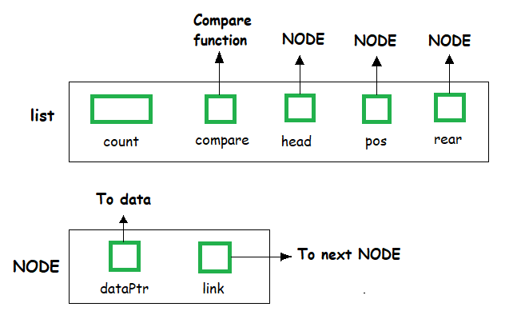
List ADT
The data is generally stored in key sequence in a list which has a head structure consisting of count, pointers and address of compare function needed to compare the data in the list.

Slide 34
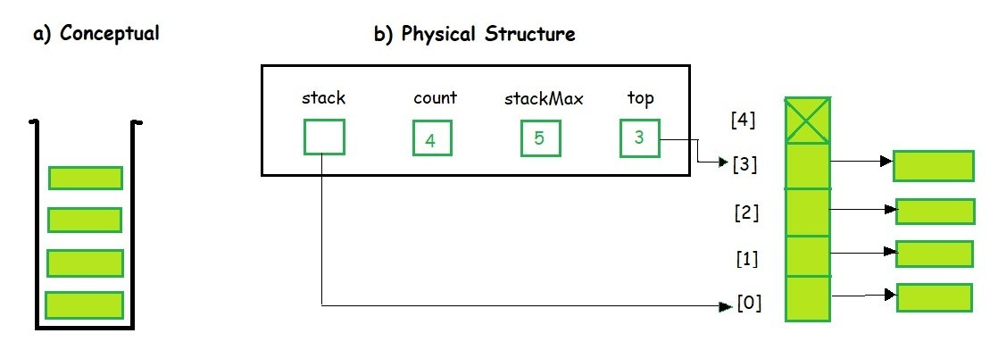
Stack ADT
In Stack ADT Implementation instead of data being stored in each node, the pointer to data is stored.
The program allocates memory for the data and address is passed to the stack ADT.

Slide 35
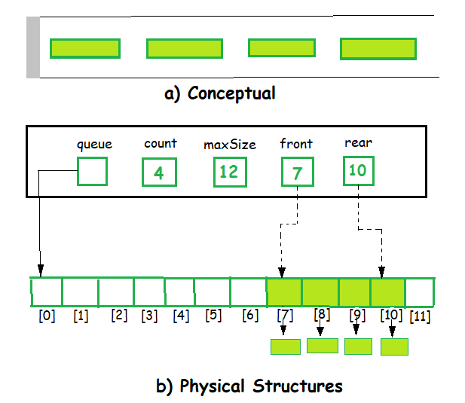
Queue ADT
The queue abstract data type (ADT) follows the basic design of the stack abstract data type.

